Slide 1

TATYASAHEB KORE INSTITUTE OF ENGINEERING AND TECHNOLOGY, WARANANAGAR [AN AUTONOMOUS INSTITUTE] DEPARTMENT OF COMPUTER SCIENCE & ENGINEERING

Slide 2
Project Title: Music Recommandation System By Emotion Prediction using Facial Expression
Presented by:
Name Roll No
Namrata Medidar 133
Susmita Janawade 139
Guidance : Prof. V.C.Patil

Slide 3
Introduction
People tend to express their emotions, mainly by their facial expressions. Music has always been known to alter the mood of an individual. Capturing and recognizing the emotion being voiced by a person and displaying appropriate songs matching the one's mood and can increasingly calm the mind of a user and overall end up giving a pleasing effect. The project aims to capture the emotion expressed by a person through facial expressions. A music player is designed to capture human emotion through the web camera interface available on computing systems. The software captures the image of the user and then with the help of image segmentation and image processing techniques extracts features from the face of a target human being and tries to detect the emotion that the person is trying to express.

Slide 4
Existing System
Existing system stated that it is very time-consuming and difficult to create and manage a large playlist.
The current mental state of the person is provided by facial expressions and the existing system was not able to capture or recognize the gestures or hand signs.

Slide 5
Problem Statement:
For a person, sometimes it is difficult to choose the song based on his current mood or
sometimes it happens that if person wants to listen the songs and he does not remember the
songs related to his current mood.

Slide 6
Objective
The objective of an emotion prediction system using facial expressions project is to
develop a computer-based system that can accurately predict human emotions based on
their facial expressions and recommending the best playlist for user based on his
current emotion.

Slide 7
Functional Requirements
Emotion Recognition: Develop a facial expression analysis module that accurately recognizes emotions such as happiness, sadness, anger, etc., from users' facial expressions in real-time.
Music Recommendation Engine: Build a recommendation engine that generates music suggestions based on the predicted emotions and users' profiles, taking into account their preferred genres, listening history, and feedback.
User Interface: Design an intuitive and visually appealing interface that allows users to interact with the system, view recommended music, and provide feedback.
Integration with Music Platforms: Enable seamless integration with popular music streaming platforms, allowing users to listen to recommended music directly or provide APIs to access the system's music library.

Slide 8
Non-Functional Requirements
Accuracy and Reliability: The emotion recognition model should have a high level of accuracy and reliability in identifying users' emotions from facial expressions.
Real-time Processing: The system should be able to analyze facial expressions and generate recommendations in real-time, providing a smooth and seamless user experience.
Scalability: The system should be capable of handling a growing user base and processing large volumes of data without compromising performance.
.User Experience: Focus on creating a user-friendly interface that is visually appealing, easy to navigate, and provides an enjoyable music discovery experience.

Slide 9
Proposed System
The proposed system benefits us to present interaction between the user and the music player.
The purpose of the system is to capture the face properly with the camera. Captured images are fed into the Convolutional Neural Network which predicts the emotion. Then emotion derived from the captured image is used to get a playlist of songs.

Slide 10
System Modules
Data collection
Emotion labeling
Feature extraction
Machine learning model training
Music recommendation

Slide 11
Class Diagram
USER
SYSTEM
gesture input
Take input process and identify category
gesture performance
gesture image
receive input ()
identify category ()
PLAYER
pass category
fetch song and play
play song
play ()

Slide 12
Data Flow Diagram
Initialization
Start
Face
Webcam
Face Detected?
No
Yes
Feature Extraction
Emotion Recognition
Song Recommendation
Stop

Slide 13
Sequence Diagram
User
Face
Preprocessing
Music
1: Web cam()
2
3 : Face Detection()
4 : Feature Extraction()
5: Emotion Recognition()
6 : Emotion Classification()
7 : Song recommendation()
8 : Final process()

Slide 14
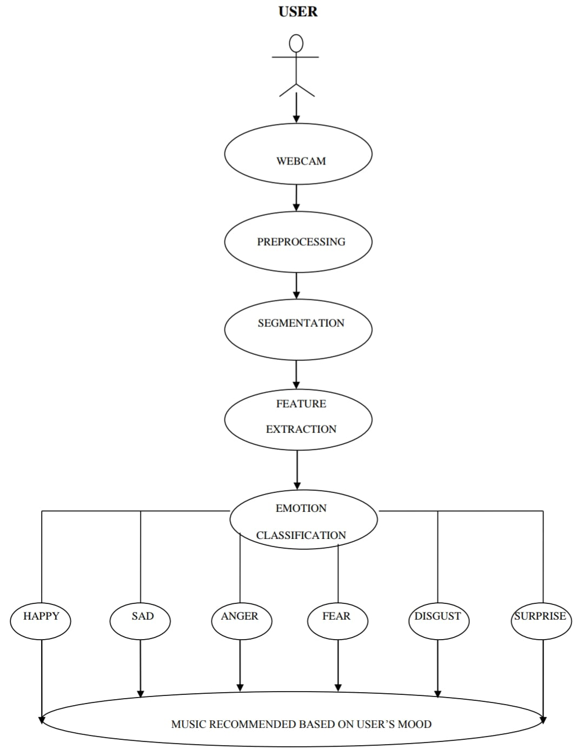
Use Case Diagram

Slide 15
Hardware and Software Requirements
Hardware Requirements
- Camera
- Processor :- 8086 Family onwords
- RAM :- 8 GB – 16 GB
- HDD :- 100 GB & above
- Graphics Processing Unit (GPU)
Software Requirements
- Platform : Windows 11
- Programming Language : Python
- Interpreter : Python Interpreter
- IDE : PyCharm Community Edition

Slide 16
Conclusion
As the power and advantages of AI-powered applications are trending, our project will be a state-of-the-art trending technology utilization. In this system, we provide an overview of how music can affect the user's mood and how to choose the right music tracks to improve the user's moods. The implemented system can detect the user's emotions. The emotions that the system can detect were happy, sad, angry, neutral, or surprised. After determining the user’s emotion, the proposed system provided the user with a playlist that contains music matches that detected the mood.

Slide 17
References
Jouranal Papers:
K.R. Prabha, B. Nataraj, R. Ajaydevan, S. Kabilan, V. Muthuselvam, "Real Time Facial Emotion Recognition Methods using Different Machine Learning Techniques", 2022 3rd International Conference on Smart Electronics and Communication (ICOSEC), pp.1415-1420, 2022.
Dong-Hyun Kang, Deok-Hwan Kim, "1D Convolutional Autoencoder-Based PPG and GSR Signals for Real-Time Emotion Classification", IEEE Access, vol.10, pp.91332-91345, 2022.
Geerish Suddul, Chandesh Lillmond, Sandhya Armoogum, "A Smart Virtual Tutor with Facial Emotion Recognition for Online Learning", 2022 IEEE Zooming Innovation in Consumer Technologies Conference (ZINC), pp.67-72, 2022.
Web References:
https://colab.research.google.com/drive/1DOvXJZRkjfKfF9oUpCZXSU3hPG3g1h-l?usp=sharing
https://doi.org/10.1109/CSITSS.2017.8447743.
Books:
Object-orientated Modelling & Design: - James Rambaugh, Michael Blaha, William Premerlani, Frederick Eddy, William Lorensen. (PHI)
The Unified Modelling Language User Guide: - Grady Booch, James Rambaugh, Lvar Jacobson.

